Slide 1
Secure Data Hiding in images using steganography
CAPSTONE PROJECT
Presented By: Shaik Karishma
Student Name : Shaik Karishma
College Name & Department : Ashoka Women’s Engineering College, MCA

Slide 2
OUTLINE
Problem Statement
Technology used
Wow factor
End users
Result
Conclusion
Git-hub Link
Future scope

Slide 3

Problem Statement
In today's digital world, securing sensitive data is very important. Traditional encryption methods protect data but make it obvious that something is hidden. Steganography solves this by hiding data inside images, making it nearly impossible to detect. However, existing methods may have limitations such as low security, poor image quality, and limited storage capacity. This project aims to develop an efficient and secure technique for embedding secret messages into images while maintaining their quality and ensuring the hidden data remains undetectable. The goal is to improve security, enhance storage capacity, and make data hiding more reliable for real-world applications.

Slide 4

Technology used
This project uses Python as the main programming language because it has many useful libraries for image processing and steganography. The key libraries include OpenCV (for handling images), PIL (Pillow) (for image manipulation), and NumPy (for working with image data). To hide and extract data, Steganography and Cryptography libraries are used for secure encoding. The platform can be Jupiter Notebook or Google Colab for easy coding and testing. For a graphical interface, Tkinter or Streamlit can be used to make it user-friendly. These tools help ensure the hidden data remains safe and undetectable inside images.

Slide 5

Wow factors
This project stands out because it offers high security by combining steganography with encryption, making the hidden data nearly impossible to detect or decode. It maintains image quality, ensuring that the modified image looks the same as the original. Unlike basic methods, this project supports different image formats and large data hiding capacity. It also features a user-friendly interface using Thinkiter or Stream light, making it easy for anyone to use. Additionally, it provides error detection and correction, ensuring data remains safe even if the image is slightly altered. These features make the project highly secure and efficient.

Slide 6

End users
This project can be useful for cybersecurity experts who need to securely send confidential data. Government agencies and military organizations can use it to protect classified information. Journalists and whistleblowers can hide sensitive data to avoid detection. Businesses and corporations can secure trade secrets and private documents. Students and researchers in cryptography and security can use it for learning and experimentation. Even regular users who want to keep personal information safe, like passwords or private messages, can benefit from this tool. It is useful for anyone who wants to hide and protect important data in a secure way.

Slide 7

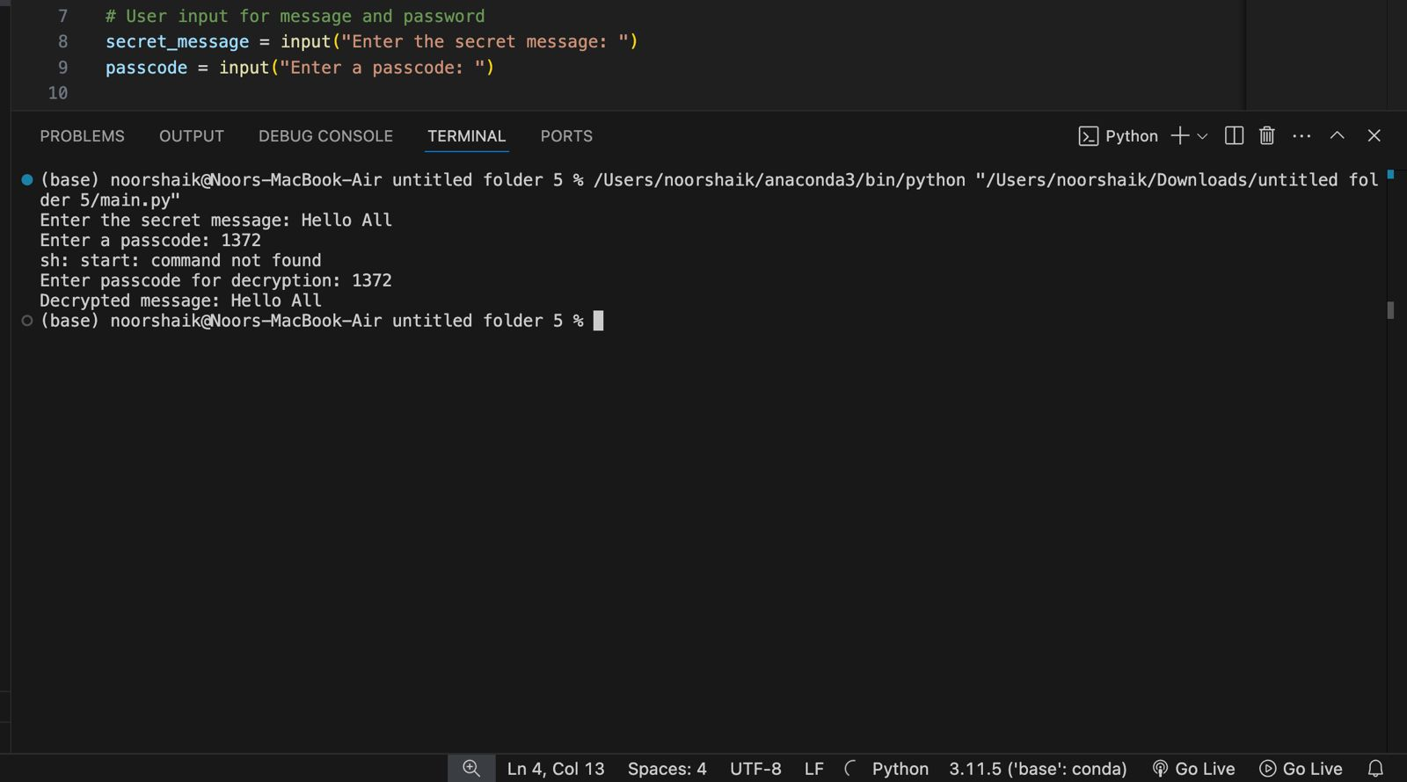
Results

Slide 8

Conclusion
This project successfully addresses the challenge of secure data hiding by using steganography to embed secret information inside images. It ensures high security, good image quality, and better data storage capacity compared to traditional methods. By combining encryption and error detection, it provides a strong and reliable solution for protecting sensitive information. The project is useful for cybersecurity, businesses, and personal data protection. Overall, it proves that steganography is an effective technique for secure communication. With further improvements, it can be widely used for privacy protection, secure messaging, andconfidential data sharing in real-world applications.

Slide 9
GitHub Link
GitHub Link: https://github.com/Karishma713/Secure-Data-Hiding-in-Images-using-Steganography

Slide 10

Future scope(optional)
This project can be improved by using advanced AI techniques to make data hiding even more secure and undetectable. Future versions can support video and audio steganography, allowing users to hide data in different media formats. Blockchain technology can be added to improve security and track data access. The project can also be optimized for faster processing and larger data storage without reducing image quality. Additionally, it can be developed into a mobile app or web platform for easier use. With these improvements, the project can become a powerful tool for secure communication and data protection worldwide.

Slide 11

Thank you

